Slide 1
Chemicals Data Tool Suite
Online user guide
Facilities available depend on subscription

Slide 2
Welcome
Monday 1st January 2023
01
Home Page
Download your own customized supply/demand database, pricing and price page dataset
02
Supply & Demand
Download supply/demand data to MS Excel, or create, save and share your own datasets
03
Trade Data
Search and download government import/export trade statistics by reporting country
04
Pricing
Monthly price histories – download prices by month or quarter, in tabular or chart format, or create, save and share monthly price history datasets
05
Chart Library
View and download regular charts relating to your subscription
06
User Datasets
Save your choice of data as a “dataset” for future download or edit

Slide 3
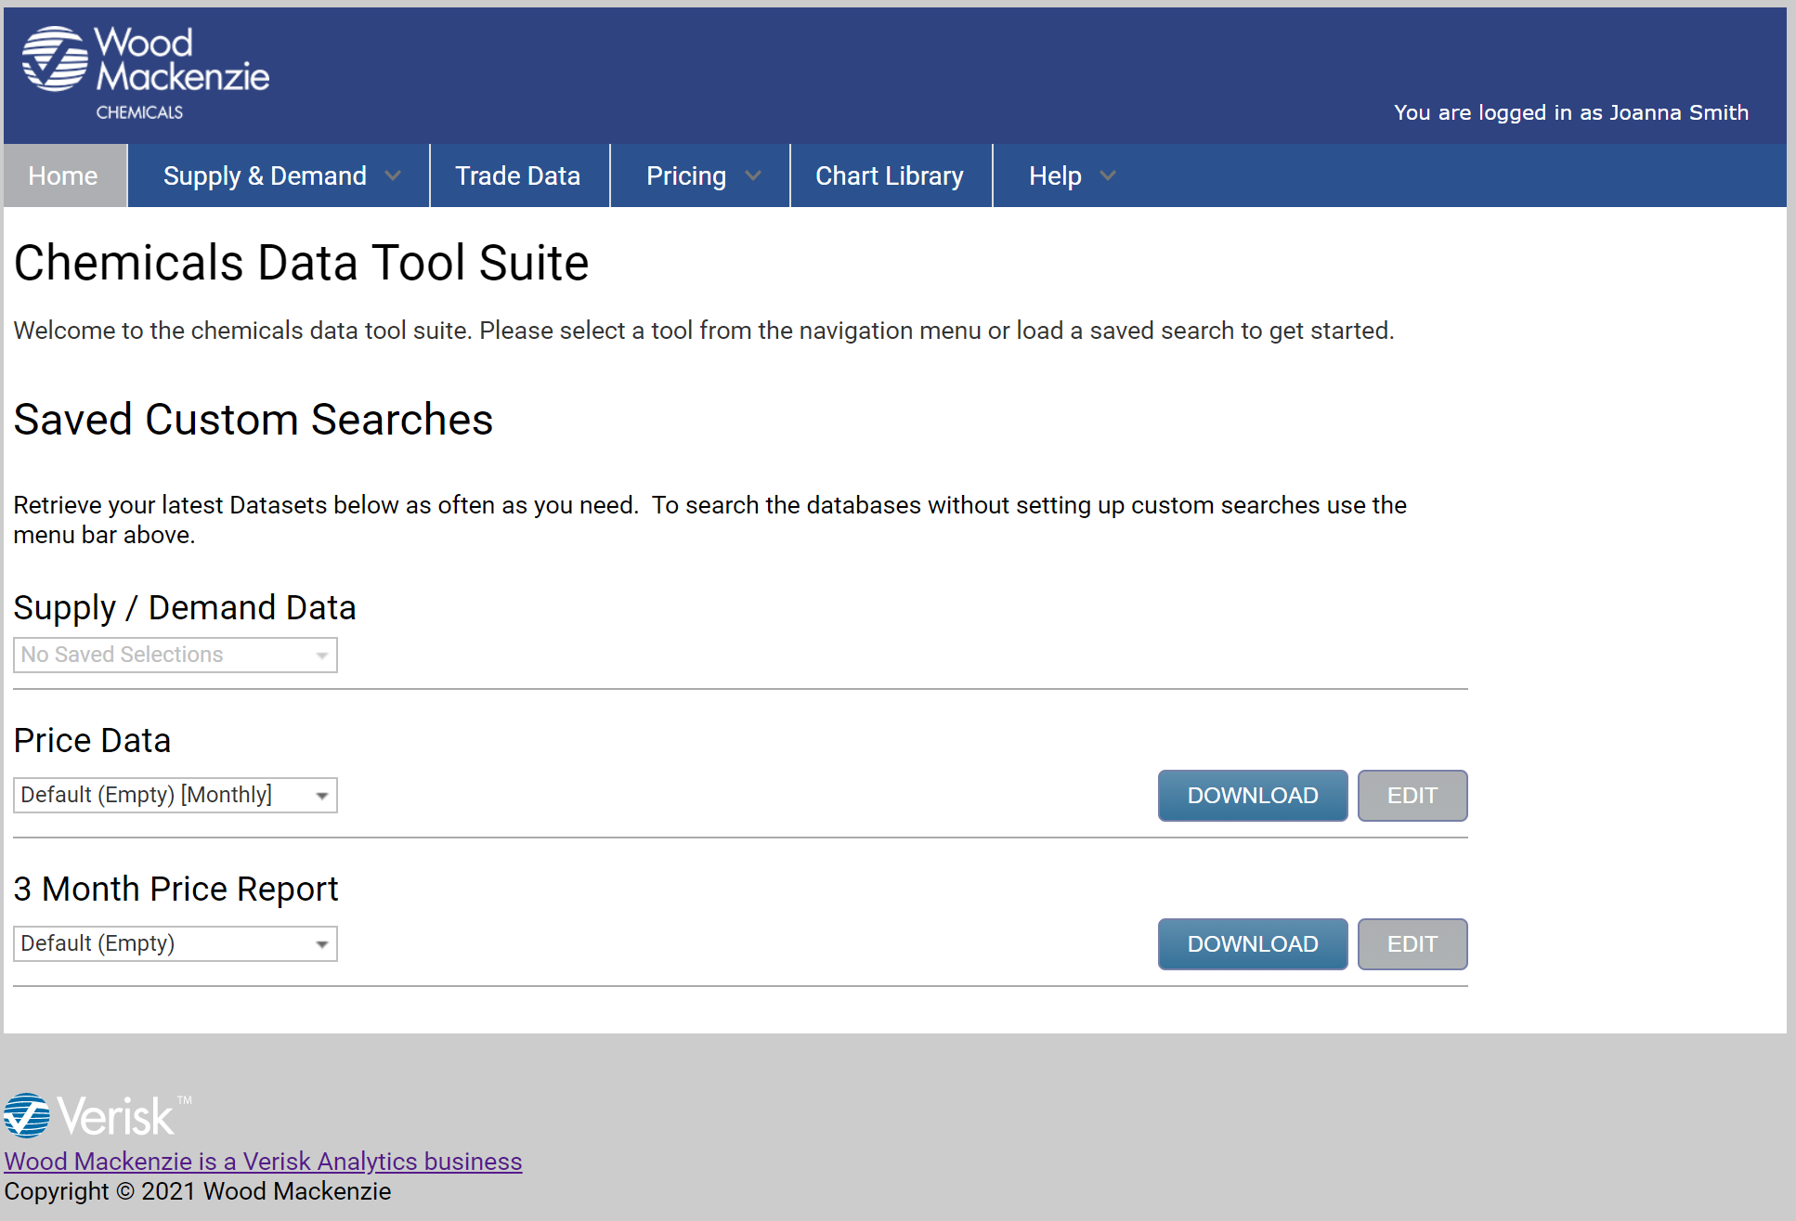

Home Page
Your homepage is customised according to your subscription
The Chemicals Data Tool Suite home page opens in a new window.
Use the main menu to navigate
Select, edit and/or download your previously saved datasets (see pages for more details)

Slide 4
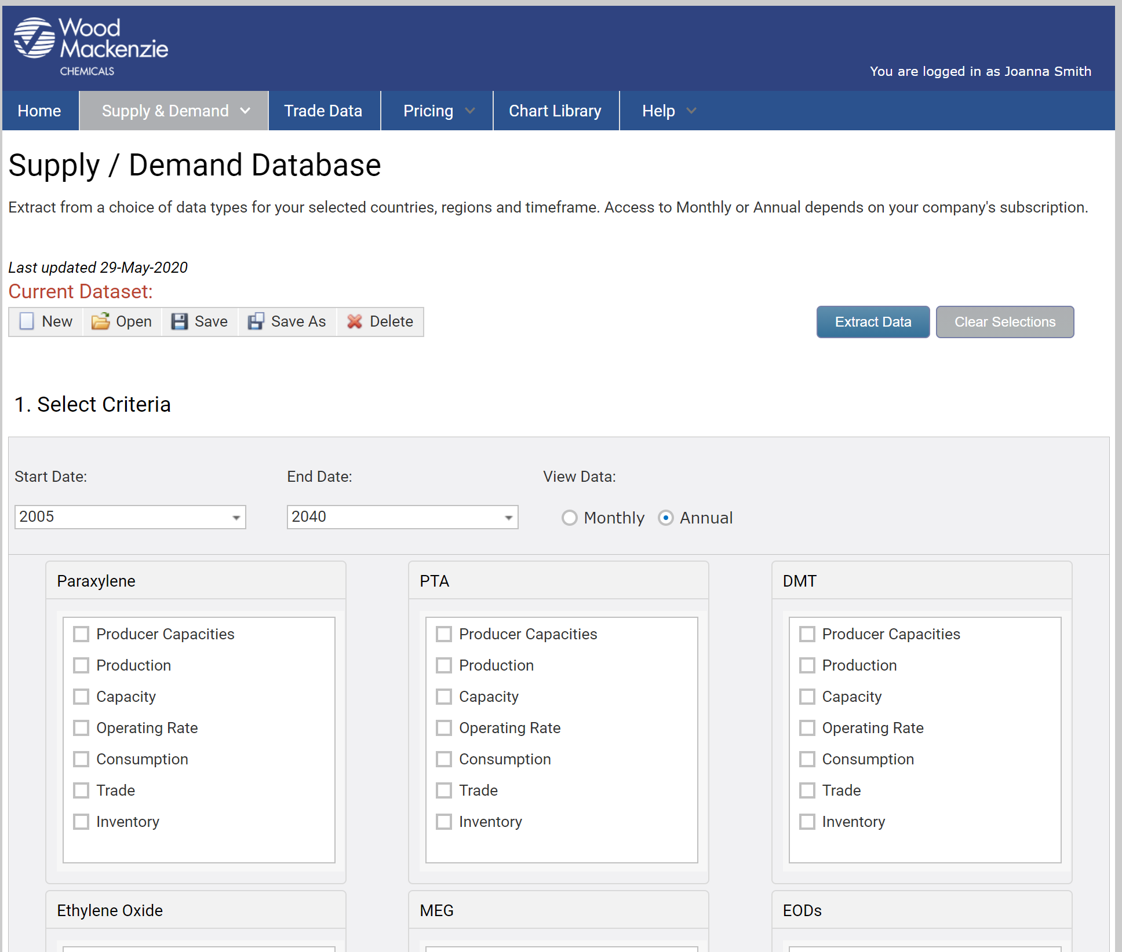
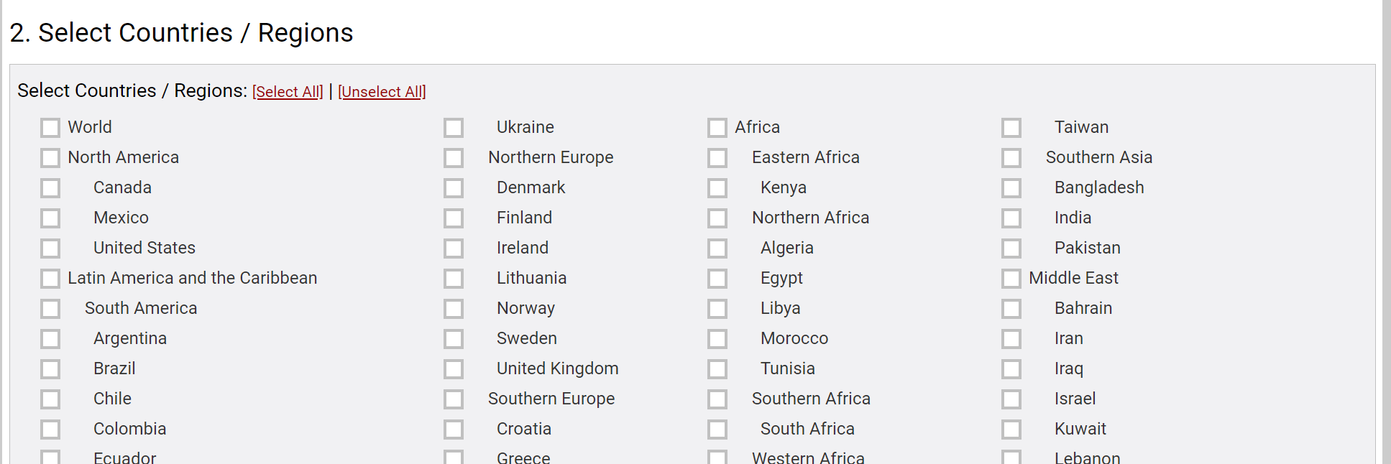
Supply & Demand Database
Step 4: Extract data into MS Excel and/or save as a dataset for future download from the home page
Create, edit, save and share datasets
Step 3: Scroll down and select your regions/countries
Step 1: Enter start/end date and frequency
Step 2: Select products and data required

Slide 5
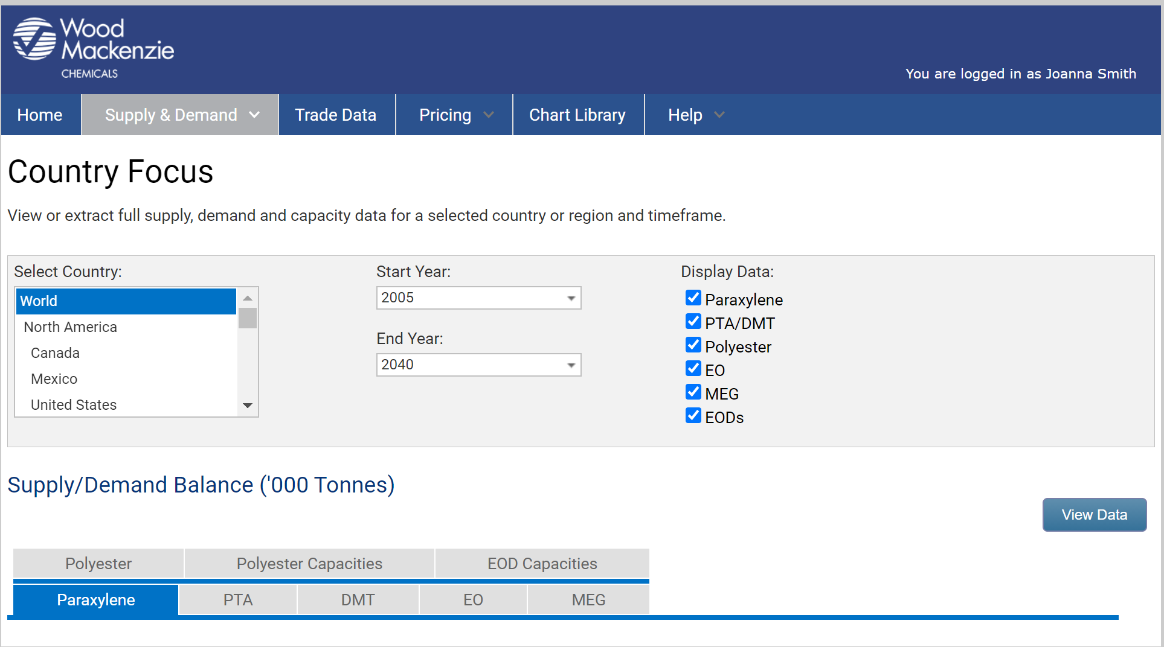
Supply & Demand Country Focus
View or extract full supply, demand and capacity data for a selected country or region and timeframe
Select the display data criteria and click on the ‘view data’ button
Choose a country and set start and end year parameters

Slide 6
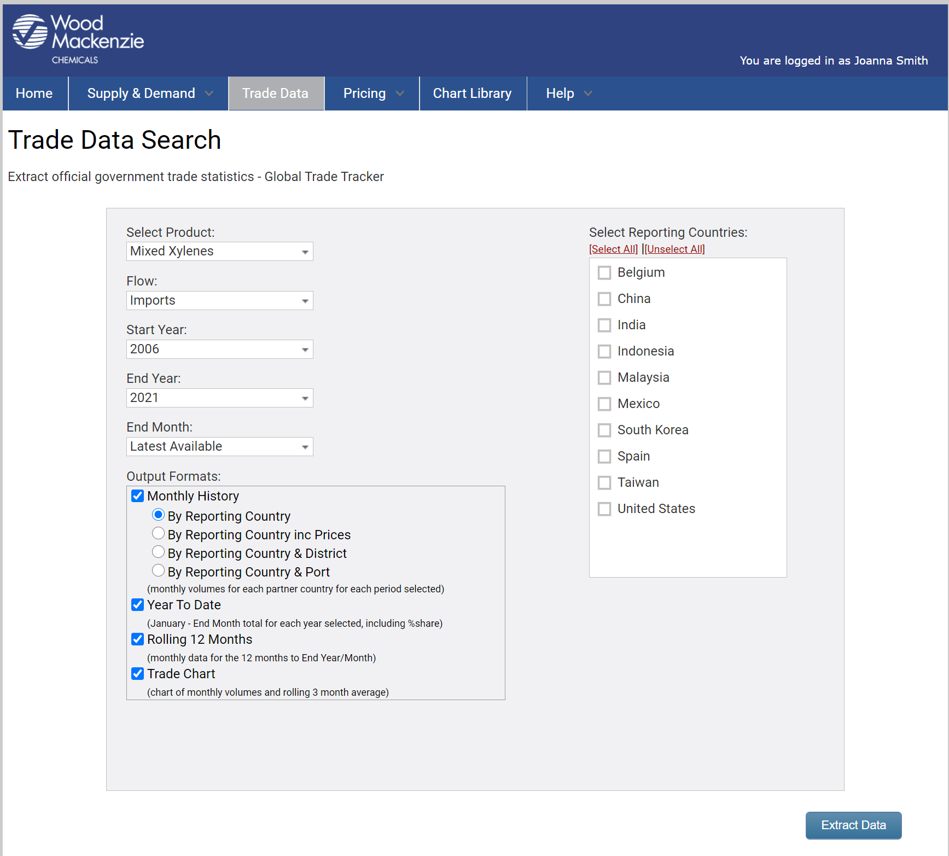
Trade Data
Search and download government import/export trade statistics by reporting country
Choose your product and data selections
Select countries and extract data to MS Excel

Slide 7
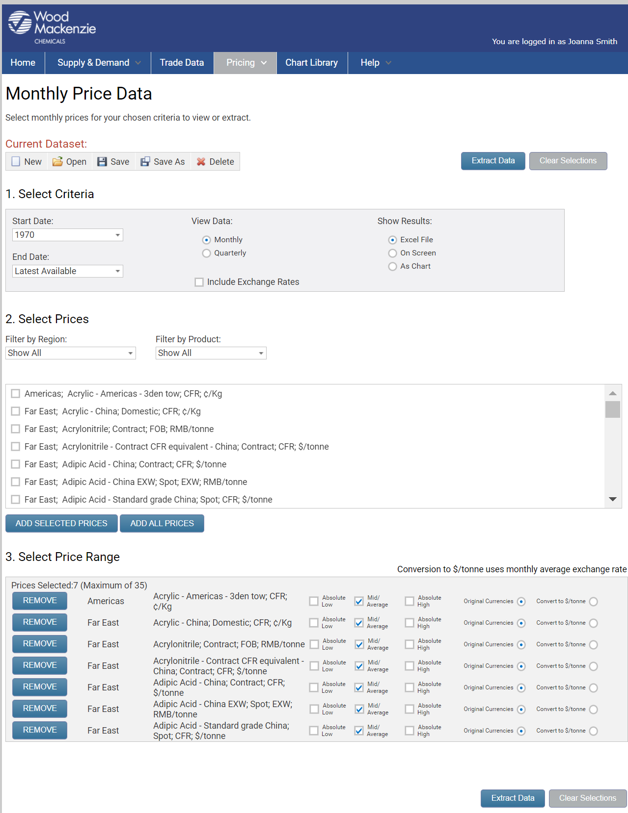
Pricing
Create, edit, save and share datasets
Monthly price data
Step 1: Select date range
Step 2: View results monthly or quarterly. Choose to extract data into MS Excel or view on screen as data or chart
Step 3: Select prices, using region and product filters is required. Click ‘Add Selected Prices’ to proceed to next stage before extracting data
Step 4: Choose price range, currency and unit
Step 5: Extract data as chosen in step 2 or save as a dataset for future download from the home page

Slide 8
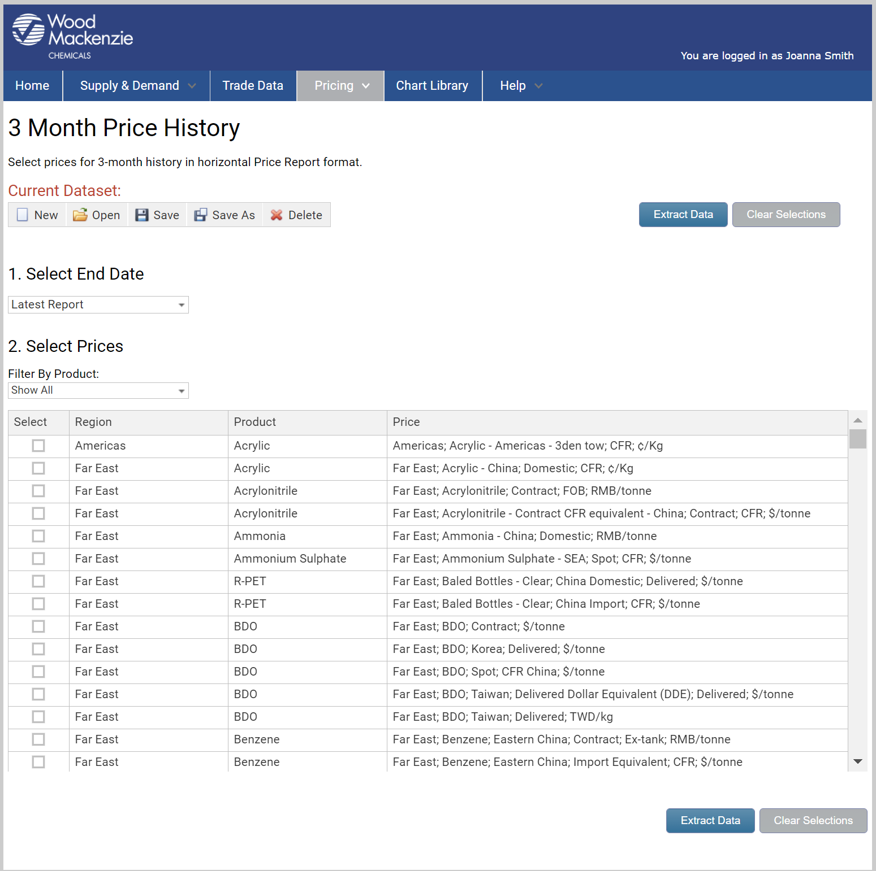
Pricing
Create, edit, save and share datasets
3-month price history
Tailor your 3 month price history to show only the prices you need each month. The output shows previous quarter, last month and current month
Choose monthly report issue and product selection (availability dependent on monthly report subscription)
Extract data into MS Excel and/or save as a dataset for future download from the home page

Slide 9
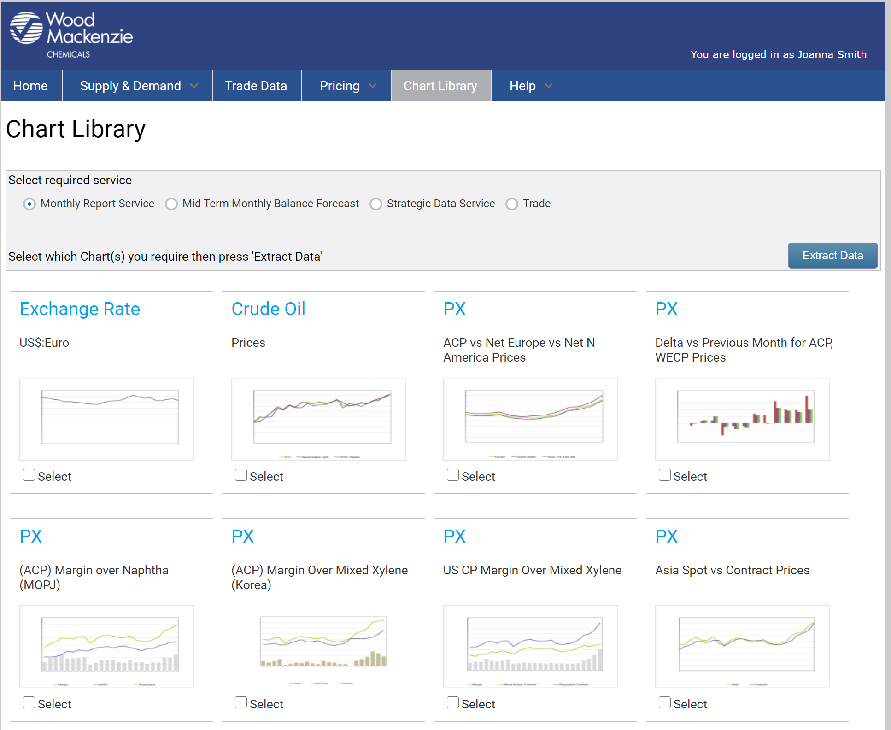
Chart Library
View and download regular charts relating to your subscription
Select the required chart(s) and parameters (if available) and extract to MS Excel
Select your subscription type

Slide 10
Using Datasets
What is a Dataset?
A dataset is a unique set of parameters which define a particular set of data. The parameters are selected, named and saved by you, the user.
The datasets created by users are only accessible from your own profile, unless you choose to share any of them with your colleagues.
Datasets can be set up for supply/demand data, price history data and monthly report price pages – dependent on which subscription you have with Wood Mackenzie Chemicals.
Datasets can be created in the relevant data section of the data tool suite and can be retrieved by users at any time from the data pages or home page.
When data is extracted using a dataset it will automatically contain the very latest available data with no need to re-input all your parameters.
Data from the data pages can be extracted without the use of a dataset. In that case the profile will not be saved for use in the future.

Slide 11
Using Datasets continued
Create a new dataset
The very first time you log into the Wood Mackenzie Chemicals Data Tool Suite your default datasets will be empty. They will remain empty until you create and save your own datasets.
To set up a dataset, select either ‘supply & demand’ or ‘pricing’ from the main menu on the home page.
Make your selection of the data, timing etc.
Click the <save as> button in the sub-menu bar and input a name for your dataset, click <save>.
Your new dataset will appear in the heading box.
Extract the data from a dataset
Users can extract the data from their dataset from the home page, or from the relevant data page. In either case the data downloaded will automatically be the latest available from our databases.
From the home page select your dataset from the drop-down box under data searches and click <download>.
In data go to the relevant page. Open the required dataset and click <extract data>.

Slide 12
Using Datasets continued
Edit an existing dataset
Users can edit a dataset at any time.
In the required data page click <open>.
Using the dropdown box select the dataset to edit. The selected dataset will open.
Change the data criteria and/or data types as required.
Click <save> to save changes to the dataset OR click <save as> and rename your dataset. You new dataset will appear in the heading box.
Share your datasets
If a user wishes to share a dataset with a colleague so that they can download the same customised data report, this can be achieved by sending the dataset to the colleague’s login profile.
In the relevant data page click <open> to open the dataset you wish to share.
Click the <share> button.
Follow the instructions to send an email alert to your colleague.
Your colleague receives the email, opens the link you have sent, logs into Wood Mackenzie chemicals online data tool with their own username and password and your dataset will be added to their datasets profile.

Slide 13
Disclaimer
Strictly Private & Confidential
These materials, including any updates to them, are published by and remain subject to the copyright of the Wood Mackenzie group ("Wood Mackenzie"), or its third-party licensors (“Licensrs”) as relevant, and are made available to clients of Wood Mackenzie under terms agreed between Wood Mackenzie and those clients. The use of these materials is governed by the terms and conditions of the agreement under which they were provided. The content and conclusions contained are confidential and may not be disclosed to any other person without Wood Mackenzie's prior written permission. Wood Mackenzie makes no warranty or representation about the accuracy or completeness of the information and data contained in these materials, which are provided 'as is'. The opinions expressed in these materials are those of Wood Mackenzie, and do not necessarily represent our Licensors’ position or views. Nothing contained in them constitutes an offer to buy or to sell securities, or investment advice. Wood Mackenzie's products do not provide a comprehensive analysis of the financial position or prospects of any company or entity and nothing in any such product should be taken as comment regarding the value of the securities of any entity. If, notwithstanding the foregoing, you or any other person relies upon these materials in any way, Wood Mackenzie does not accept, and hereby disclaims to the extent permitted by law, all liability for any loss and damage suffered arising in connection with such reliance.
Copyright © 2023, Wood Mackenzie Limited. All rights reserved.
13
13

