Slide 1

How to download reports from the Wood Mackenzie Chemicals Portal

Slide 2

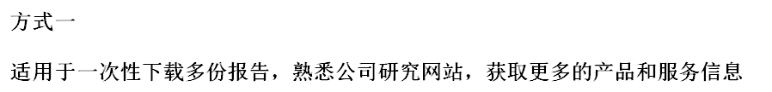
01
https://portal.pciwoodmac.com/content/pages/login.aspx?signout=true

Slide 3
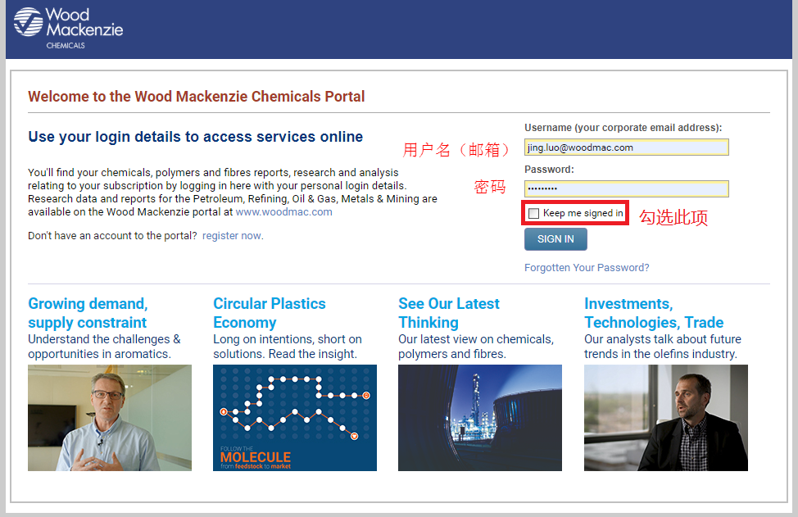

02

Slide 4
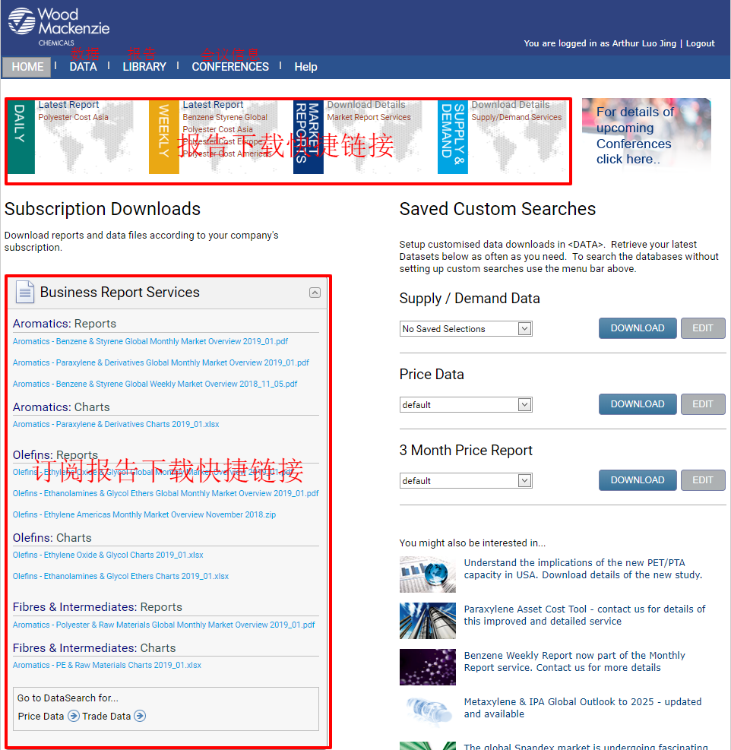



03
4

Slide 5

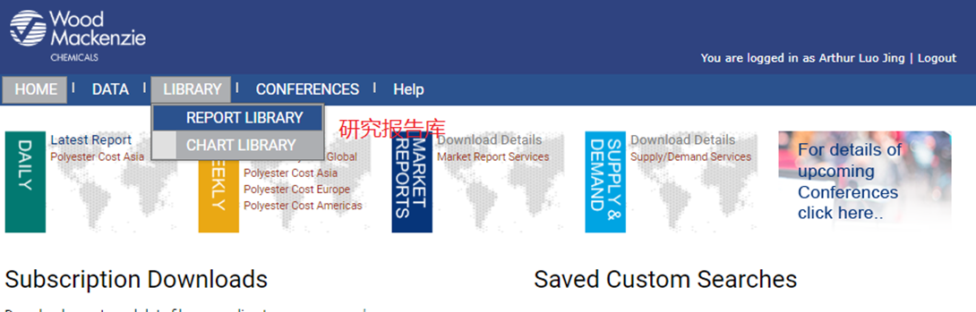
04
5
5

Slide 6
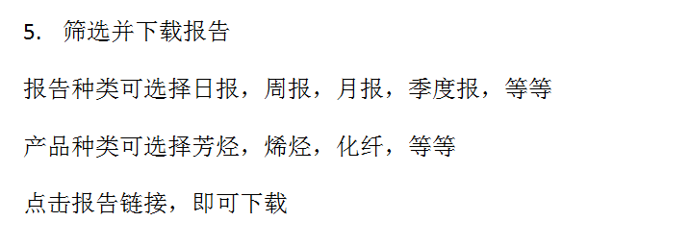
05
6
6

Slide 7
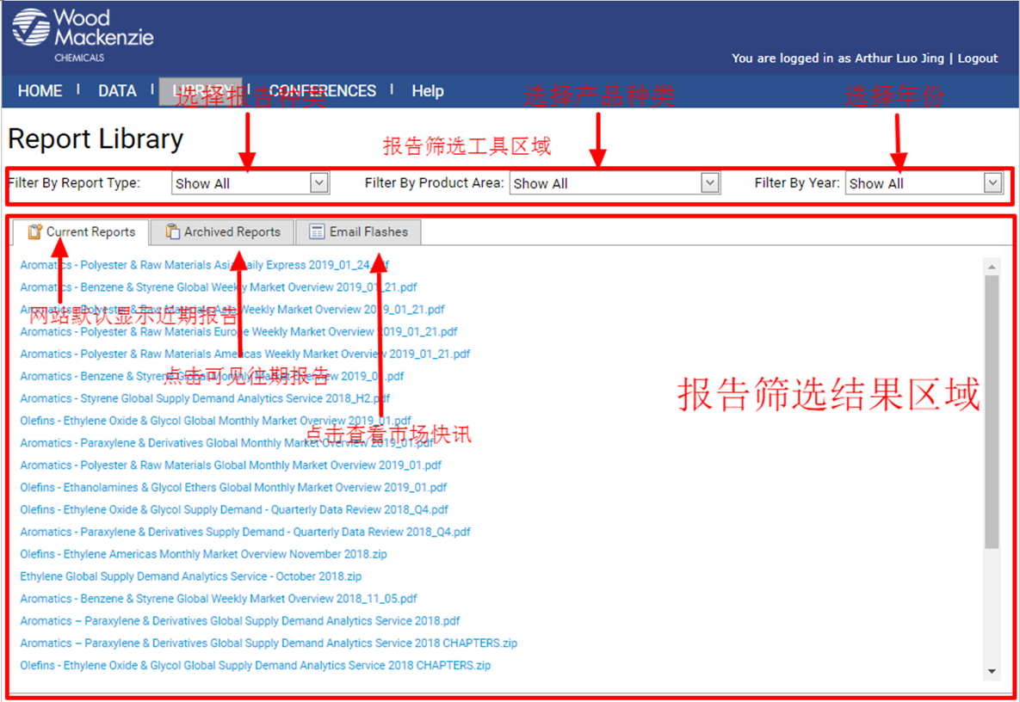

Slide 8



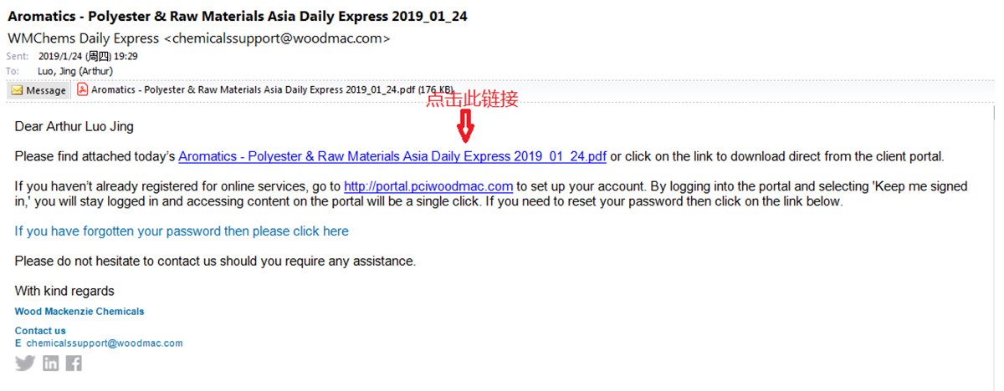
01

Slide 9

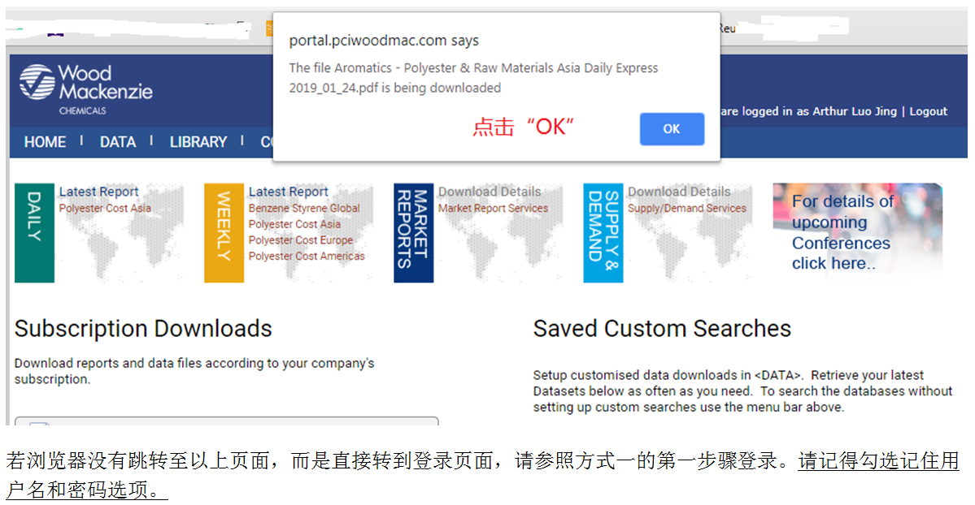
02

Slide 10
Disclaimer
Strictly Private & Confidential
These materials, including any updates to them, are published by and remain subject to the copyright of the Wood Mackenzie group ("Wood Mackenzie"), or its third-party licensors (“Licensrs”) as relevant, and are made available to clients of Wood Mackenzie under terms agreed between Wood Mackenzie and those clients. The use of these materials is governed by the terms and conditions of the agreement under which they were provided. The content and conclusions contained are confidential and may not be disclosed to any other person without Wood Mackenzie's prior written permission. Wood Mackenzie makes no warranty or representation about the accuracy or completeness of the information and data contained in these materials, which are provided 'as is'. The opinions expressed in these materials are those of Wood Mackenzie, and do not necessarily represent our Licensors’ position or views. Nothing contained in them constitutes an offer to buy or to sell securities, or investment advice. Wood Mackenzie's products do not provide a comprehensive analysis of the financial position or prospects of any company or entity and nothing in any such product should be taken as comment regarding the value of the securities of any entity. If, notwithstanding the foregoing, you or any other person relies upon these materials in any way, Wood Mackenzie does not accept, and hereby disclaims to the extent permitted by law, all liability for any loss and damage suffered arising in connection with such reliance.
Copyright © 2023, Wood Mackenzie Limited. All rights reserved.
10
10

